Slide 1
Cryptocurrency for Energy Conscious Investors
Analysis & Comparison of an Eco-Friendly Crypto Portfolio
Julia Harrison, Harry Oestreicher, & Johnny Schiliró

Slide 2
Eco-Conscious Crypto?
Problem & Background
Bitcoin has about 45% of the crypto market or 570.252 billion USD
Ethereum has about 20% of the crypto market or 243.536 billion USD
Together – Both individually consume as much energy as two medium sized countries!
How do we measure Energy Consumption?
By Kilowatt/Terrawatts per transaction, carbon emissions & renewable resources like wind/solar
Proposal
Compare POS & POW for energy efficiency and costs associated with energy usage, rank them, offer
a sample portfolio of “EcoCrypto” picks for investors who value the environment & profit!
PoW –
Bitcoin (BTC-USD)
Ethereum (ETH-USD)
PoS –
Solana (SOL-BTC & ETH)
Cardana (ADA-BTC & ETH)
Algorand (ALGO-BTC &ETH)
Tezos (XTZ-BTC & ETH)

Slide 3
Method
Hypotheses
Proof of Stake cryptocurrencies (no matter their expected use) are more environmentally friendly
than non-Proof of Stake cryptocurrencies (specifically comparing Proof of Work cryptocurrencies).
Proof of Work cryptocurrencies outperform Proof of Stake cryptocurrencies in regards to cumulative returns,
however Proof of Stake cryptocurrencies are less volatile and less risky.
Define and distinguish eco-friendly and non eco-friendly blockchain technologies
Define PoW and Pos Portfolios
Fetch and compile Historical Data
Analyze Volatility
Analyze Risk
Monte-Carlo Simulation

Slide 4
Energy & Efficiency Data Compiled

Slide 5


Data Collected & Explored via Coinbase

Slide 6
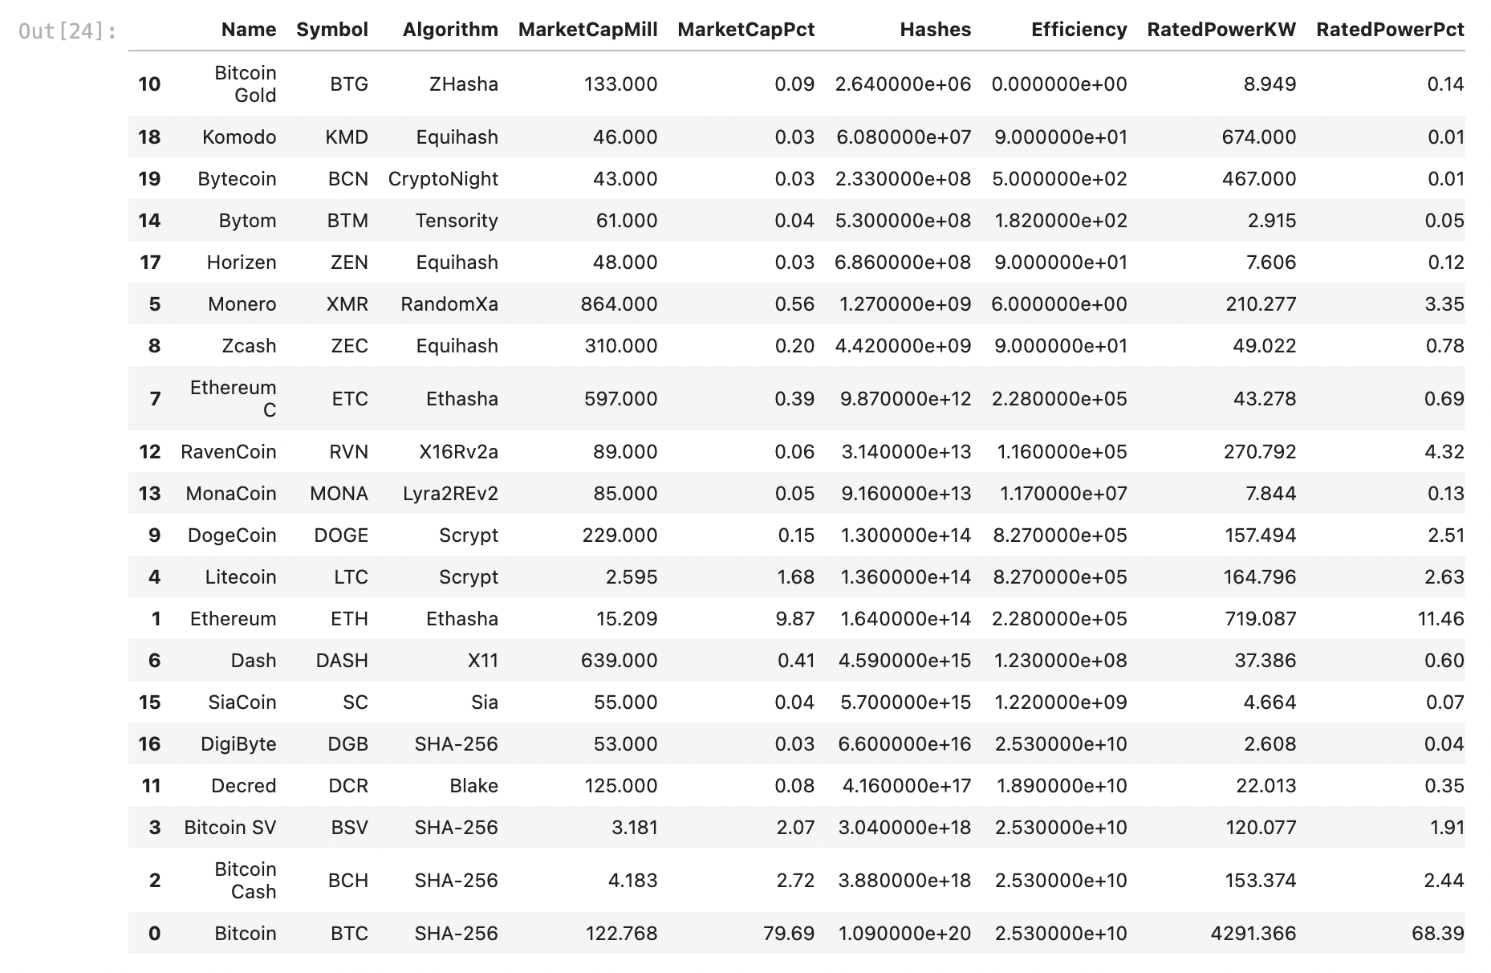
20 Mineable Cryptocurrencies

Slide 7
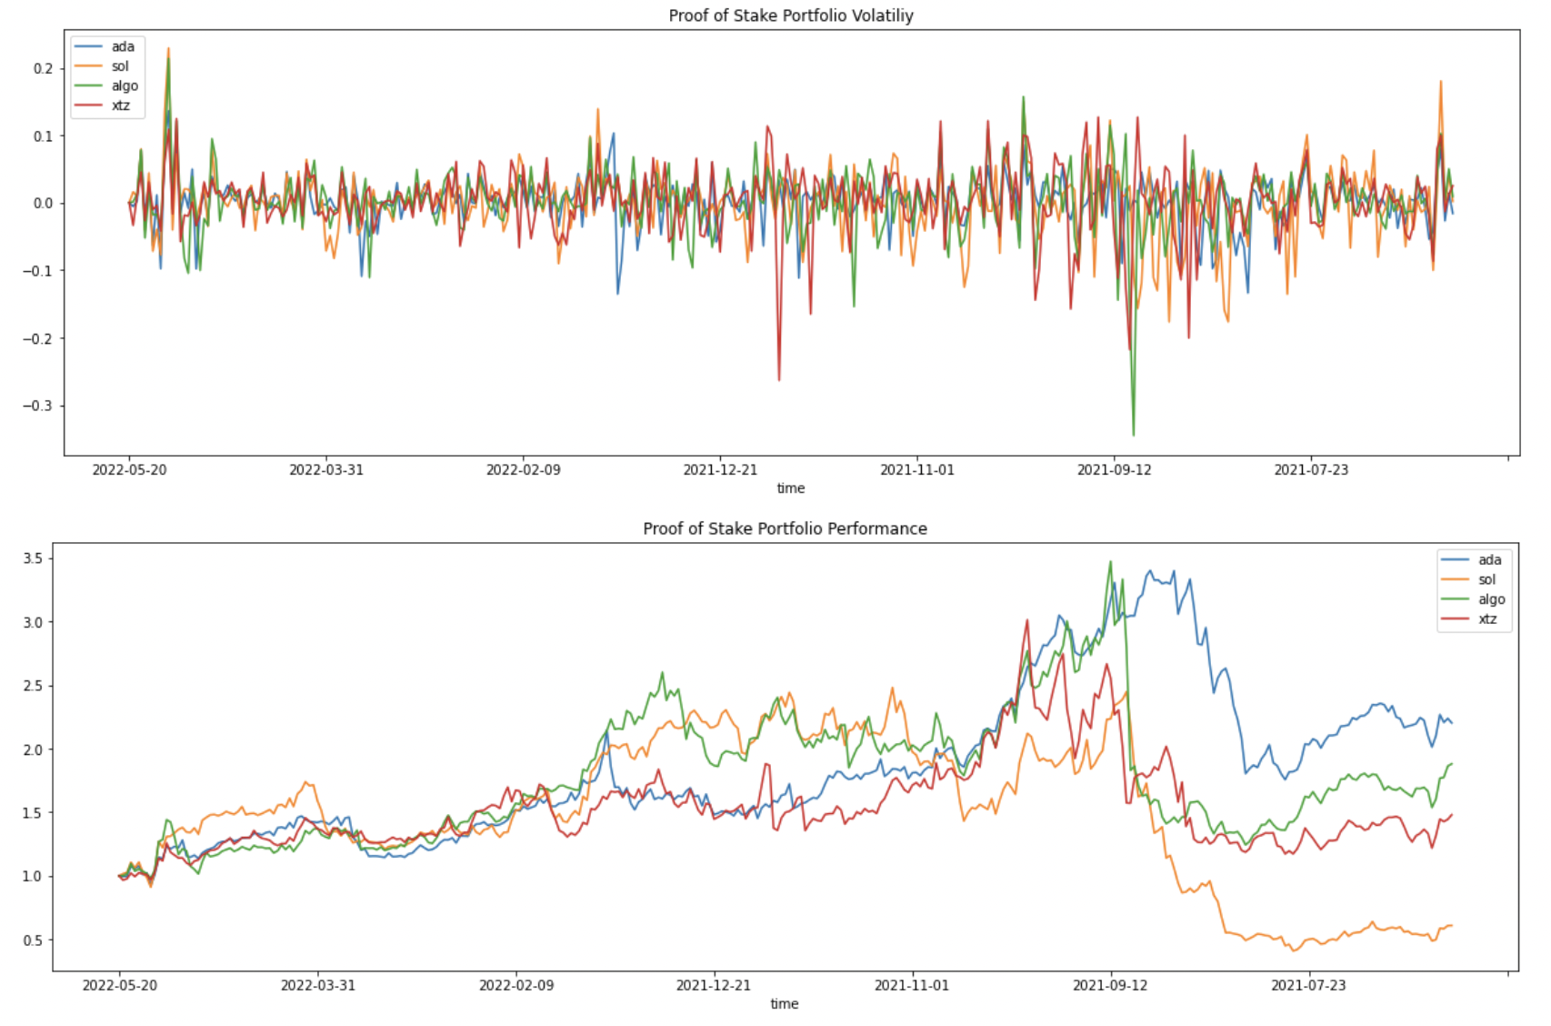
Performance & Volatility

Slide 8
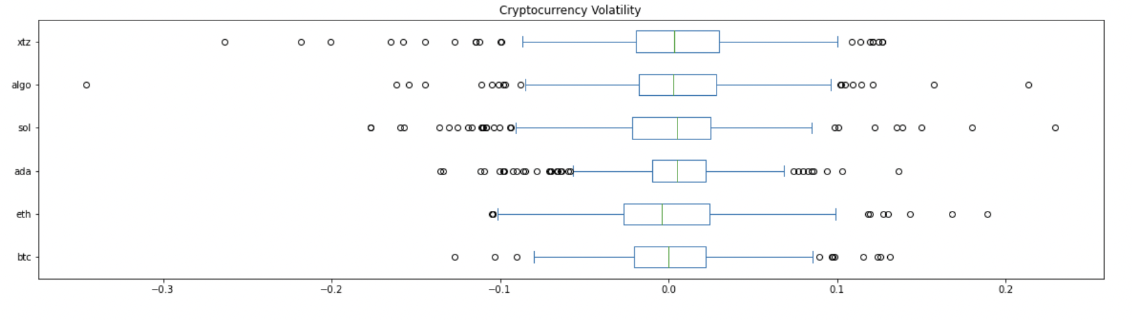
Volatility Cont.
\

Slide 9
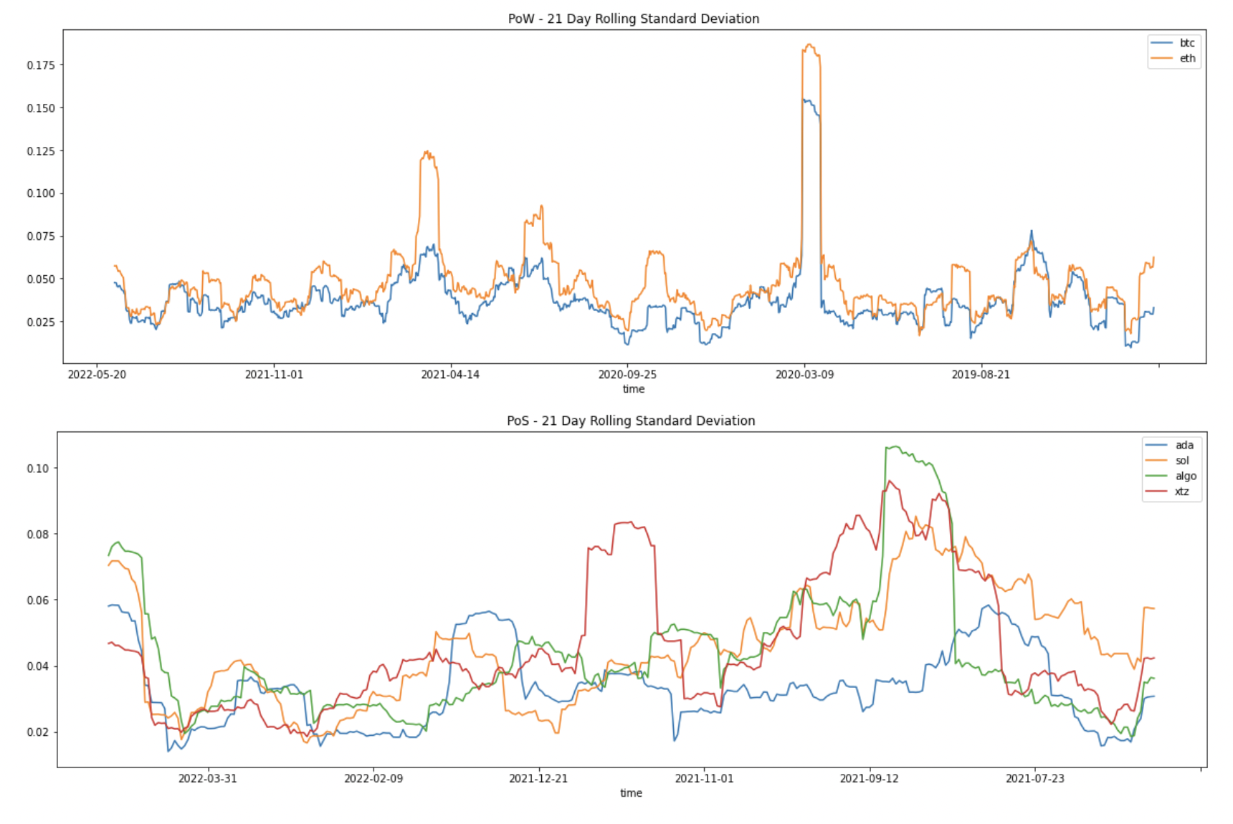
Risk

Slide 10
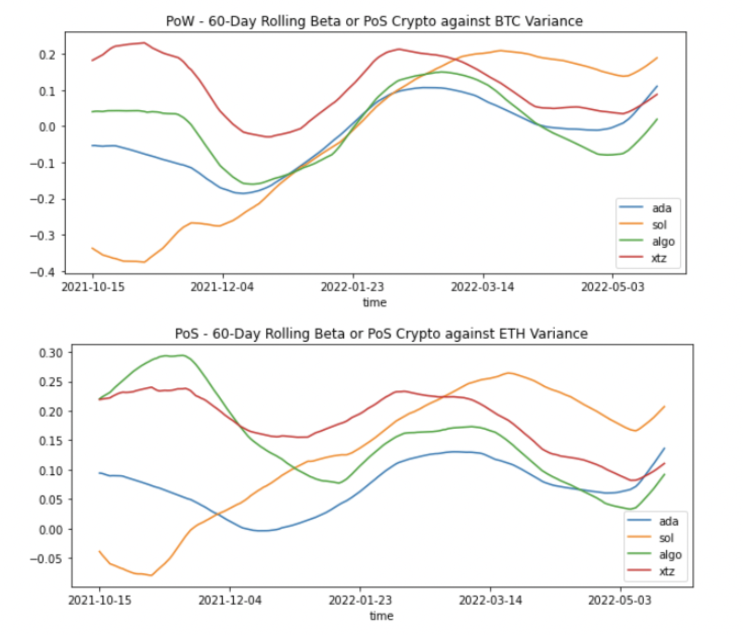
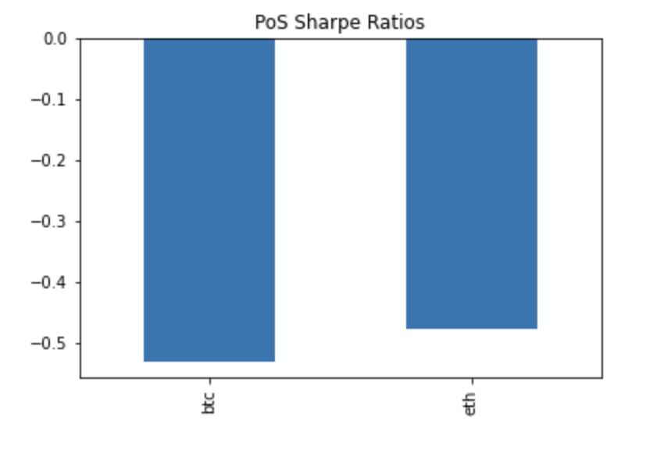
Risk Cont.

Slide 11
Performance & Volatility Comparison

Slide 12
Daily Returns

Slide 13
Portfolio Volume Comparison

Slide 14
Monte Carlo Simulation

Slide 15
Conclusions
*The energy mechanism (PoS vs. PoW) is closely related to the total energy consumed of any given crypto currency
*Proof of Work consensus mechanisms are MUCH less efficient than Proof of Stake consensus mechanisms
*Energy efficiency of the crypto is an important parameter to measure against BTC & ETH who are highly energy inefficient
*Cryptocurrencies are still a fairly volatile commodity regardless of energy consumption, trends in the value of these commodities remains unpredictable

Slide 16
Recommendations & Future Research
* Businesses, local, state, and national governments should consider the energy consumption & efficiency of blockchain technologies, as well as longterm environmental impact. EXAMPLE – Miami local govt use!
*More focus on renewable energy sources for blockchain solutions
*Software Engineers should develop alternative types of consensus mechanisms & verification protocols to avoid excessive energy consumption as crypto becomes more popular
*Purchase eco-friendly crypto to become a part of the solution!

